Slide 1
BIRD 101

Slide 2
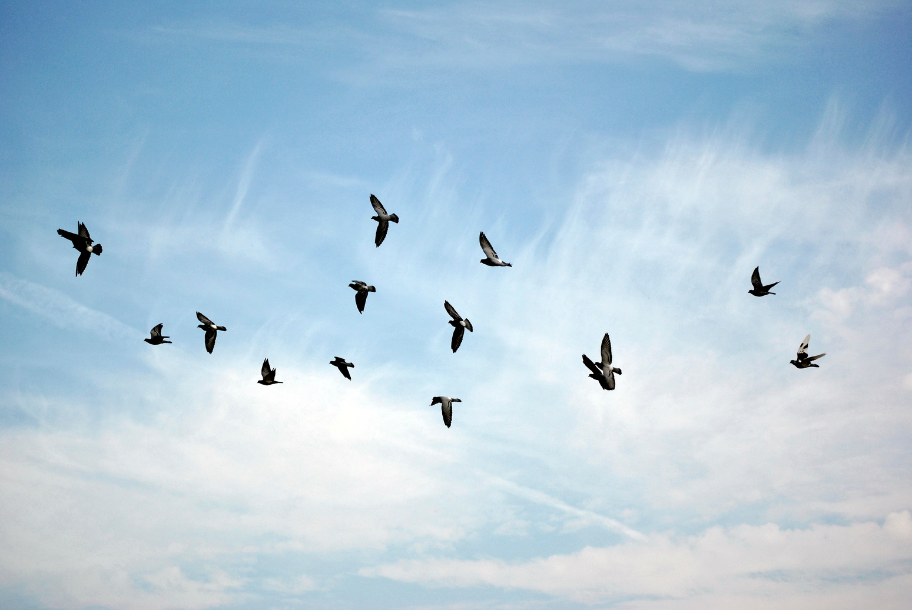
Bird can fly

Slide 3
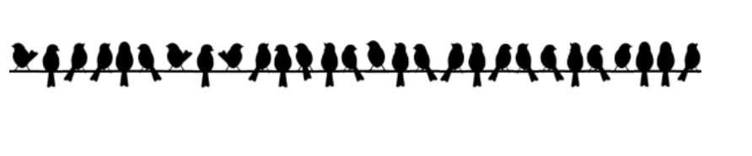
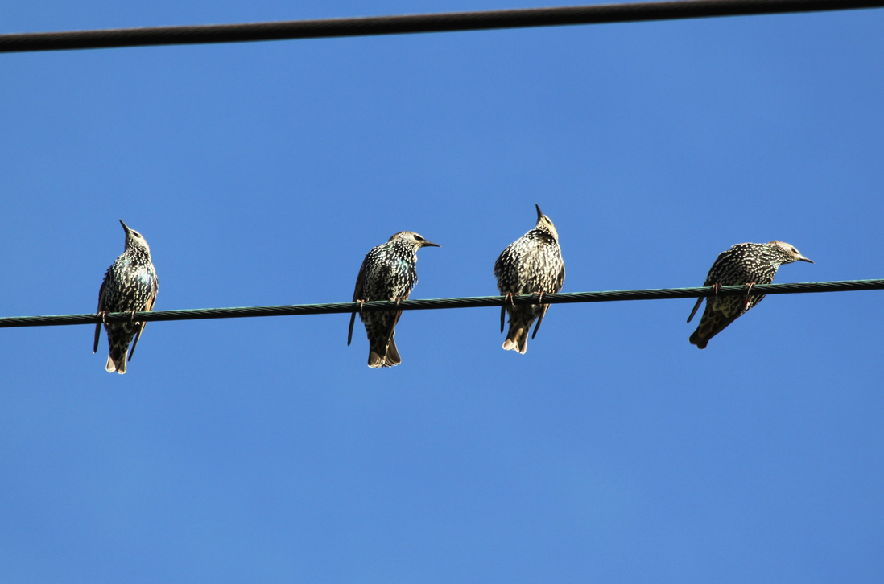
Birds like to stand on wires

Slide 4

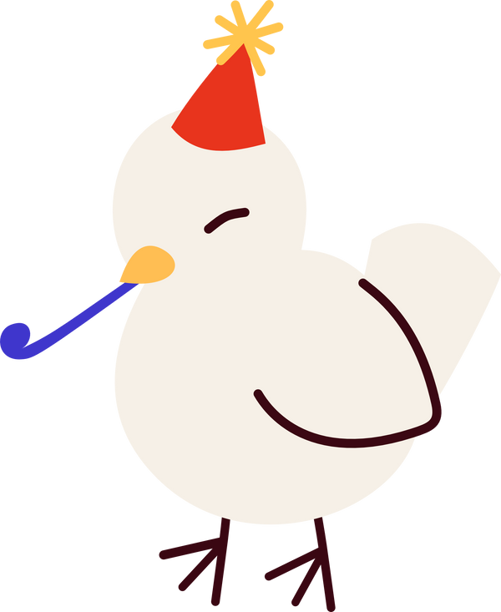
Birds like to party too!

Slide 5
Thanks for reading
v1t{fake_bird_flag}

